Slide 1
Listening Skills

Slide 2
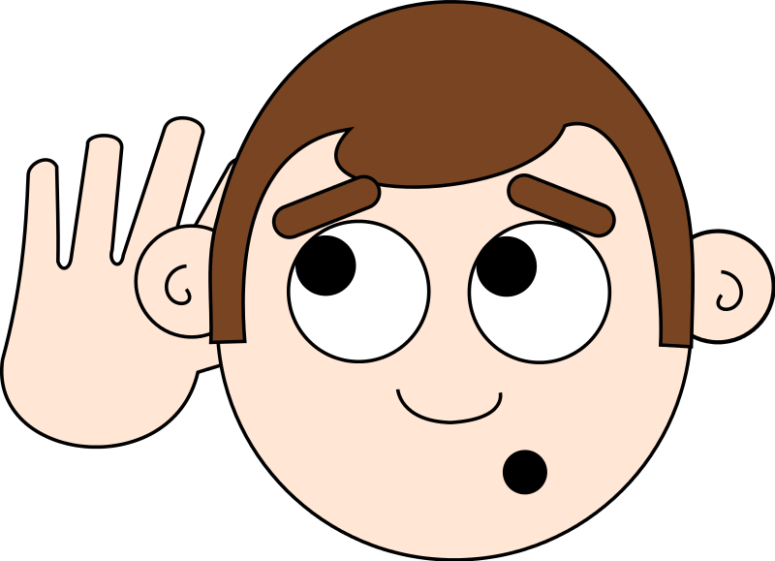
What is the difference between Hearing and Listening?

Slide 3
The Difference
Hearing
According to the dictionary, hearing is defined as “the process, function or power of perceiving a sound.”
Listening
On the other hand, the same dictionary defines listening as “to hear something with thoughtful attention.”

Slide 4
Listening
Listening comprehension is not something that happens because of what the speaker says, but “the listener has a crucial part to play in the process, by activating various types of knowledge and by applying what he knows to what he hears and trying to understand what the speaker means” (Anderson & Lynch, 1988: 6).

Slide 5
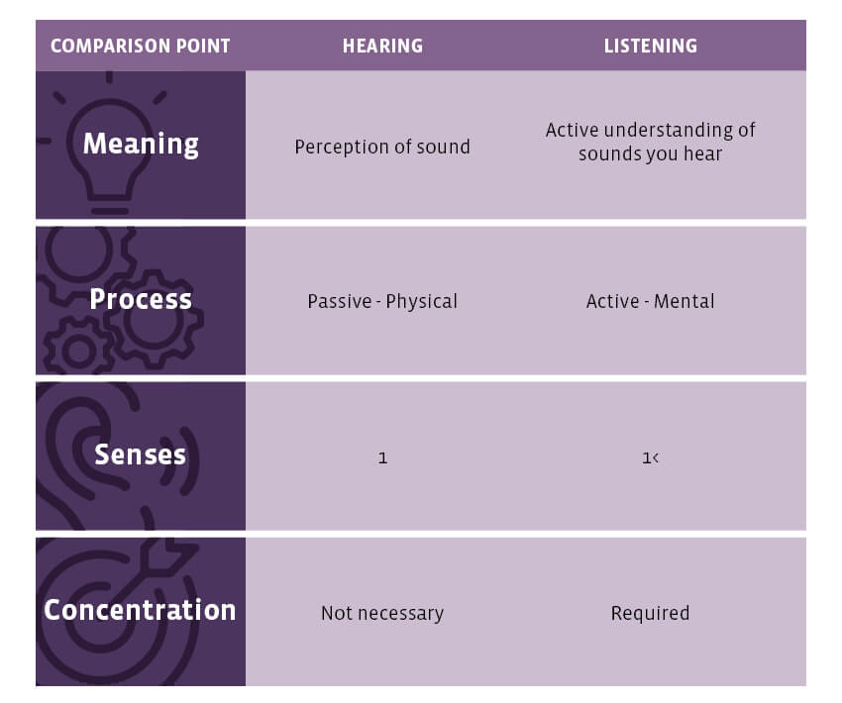

Slide 6

Why do you think Listening is an important skills to master?

Slide 7
Importance of Good Listening
Effective listeners hold higher positions (your employer will decide to hire you through his/her listening skill).
Listening is ranked as high as speaking skills by most of the employers.
The first test of listening happens in the job interview. Both your listening and speaking skills are assessed along with the expertise.
A number of studies have shown strong correlation between listening and academic success. Students with the highest grades are usually those with the strongest listening skills.
Listening is the key way you get most of your ideas and information-from television, radio, conversation, and lectures.

Slide 8
Communication is not complete without effective listening
An attentive listener stimulates better speaking
A good listener learns more than an indifferent listener
A good listener can restructure vague speaking in a way that produces clearer meaning
A good listener learns to detect prejudices, assumptions and attitudes

Slide 9
Listening Types
Appreciative
Listening for pleasure or enjoyment
Empathic
Listening to provide emotional support to a speaker
Comprehensive
Listening to understand the message of the speaker
Critical
Listening to evaluate a message to accept/reject it

Slide 10
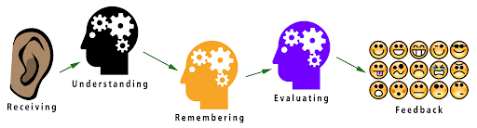
The Process of Listening

Slide 11
The Process of Listening
Receive-act of physical hearing and making sense of the sounds
Understand-message is absorbed and decoded as per the listener’s psychology
Remember-message stored
Evaluate-Message evaluated and judged, opinion formed
Respond-give feedback

Slide 12
Four Causes of Poor Listening
Lack of Concentration-Mind drifting away, inability to repress interfering thoughts
Listening too Hard-Listening to everything
Jumping to Conclusions-Letting prejudices, preconceived ideas, personal expectations interfere
Focusing on Deliver and Personal Appearance

Slide 13
Improving Listening Skills
Be an active Listener
Don’t be diverted by appearance or delivery
Suspend judgment
Resist distraction
Focus your listening
Develop note-taking skills

Slide 14
Active Listening
Pay undivided attention
Do not interrupt, be patient
Avoid distractions
Do not prejudge the speaker

Slide 15
Resist Distraction
You need to put in a conscious effort to focus and pull your mind back to the speaker. You can
Try to think ahead or the speaker, that is, anticipate what will come next.
Measure what the speaker says against what you anticipated.
Review mentally what the speaker has already said and make sure you understand it.
Listen to in between the lines messages and try to get the implications.
Assess the non-verbal communication and its relationship with verbal communication.

Slide 16
Don’t be diverted by Appearance or Delivery
Negative impression based on appearance and manner of speech-Be on guard!
Don’t be charmed by an attractive speaker with hypnotic speaking skills!

Slide 17
Suspend Judgment
The aim of active listening is to set aside “one’s own prejudices, frames of reference and desires so as to experience as far as possible the speaker’s world from the insider.”
So, avoid
Dismissing a speaker without listening
Arguing mentally with the speaker
Judging based on any preconceived idea or impressions/stereotypes
In short, listen for ideas, examine their evidence, assess their reasoning, and then make up your mind.

Slide 18
Focus your Listening
Listen for Main Points (Major themes/assertions/sub-topics)
Listen for evidence (is it accurate, credible, relevant, sufficient?)
Listen for Technique (what strategies has the speaker used to make the message interesting, clear, impactful?) (is the speaker fluent, dynamic, convincing?)

Slide 19
In Summary,
Think about utterances- opening? Questions? Conclusions? Connection of ideas?
Remove distractions, biases, judgements, value the message, Take notes.
Focus on both verbal and nonverbal messages, omissions, consistent and inconsistent packages.
Develop balance between surface and hidden meanings.
Don’t resist or filter out difficult or unpleasant messages.
Listen to the speaker`s feelings as well as to thoughts and ideas- empathy.
Don’t distort messages because of the “friend-or-foe” factor.

Slide 20
In Summary,
Avoid prejudging, filtering out difficult, unpleasant, or undesirable messages.
Avoid distorting messages through oversimplification or leveling, the tendency to eliminate details, and to simplify complex messages to make them easier to remember.
Recognize your own biases and avoid assimilation—the tendency to reconstruct messages or make your own explanations according to your own attitudes, prejudices, needs, and values.

Slide 21
Signs of Active Listening
Non-Verbal
Smile
Eye contact
Positive posture (unfolded arms, head forward titled, encouraging facial expressions)
Head nods
Verbal
Positive comments that show listening (very good, yes, indeed..)
Asking relevant questions
Make statements that summarize the speaker’s points
Asking for clarification

Slide 22
Benefits of active listening
Builds deep trust - As you cultivate the habit of listening sincerely, you invite people to open up. They can sense that you will not be jumping to conclusions based on superficial details. They also realize that you care enough about them to listen attentively. While building trust takes time, it leads to great benefits such as lifelong friendships and a promise of help in difficult times.
Broadens your perspective - Your own perspective in life is not the complete truth or how everyone else sees it. The way you understand life from your beliefs and thinking is only one way to look at it – listening to other people’s perspectives allows you to look at life from different perspectives, some of which you may not have thought of before.

Slide 23
Benefits of active listening
Strengthens your patience - The ability to be a good listener takes time and you need to develop it with regular efforts over time. An automatic benefit is that you develop patience. Patience to let his or her feelings and thoughts honestly while you don’t judge.
Makes you approachable - As you present yourself as a patient listener, people feel more naturally inclined to communicate with you. By being there for them, you give them the freedom to express their feelings.
Increases competence and knowledge - Great listening skills make an employee more competent and capable, regardless of their position. The more an individual can get information out of the meetings, the instructions, and reports provided to him, the more efficient and successful they will be at completing the task. Listening also builds knowledge and helps fulfil work requirements through progressive learning.

Slide 24
Benefits of active listening
Saves time and money - Effective listening not only reduces risks of misunderstanding and mistakes that could be very damaging to the business, it saves time and money by avoiding starting a task or a project over again, just because the directives given were misunderstood. Employees do not waste precious time and a specific budget allocated to a project.
Helps detect and solve problems - As a leader, they should always be attentive to what employees have to say. In the workplace, they are the first ones to spot flaws and come up with suggestions for improvements. Listening to colleagues will help you understand what needs to be changed and worked on to retain talent and make improvements.

